Slide 1
Writing Papers in the Biological Sciences
An introduction to Biological research and paper writing

Slide 2
Chapter Seven :Drafting and Revising
The First Draft:
  Devise a working title
  Make an outline
  Start with the easiest section
  Brainstorm with others
  Have someone else proofread your paper***

Slide 3
Practical Suggestions for Revising:
Break down the task into several successive steps.
Find specific strategies that work for you.
Do not discard your early drafts; keep everything at least until you have submitted the final version of the paper.
Spell-checkers will locate misspelled words or typos.
Remember to update the backup file each time you make revisions (keep backup copy always***).

Slide 4
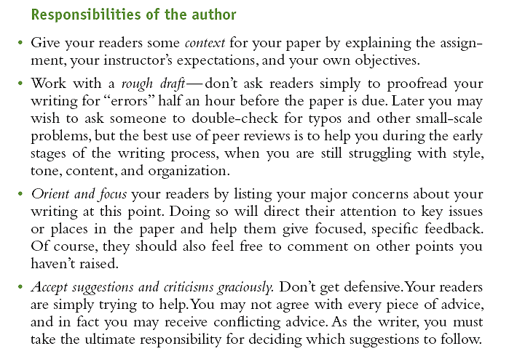
Solicit comments from others.

Slide 5

Solicit comments from others.
Understand the writer’s chief concerns, as well as the context and purposes of the assignment.
Be focused and specific in your comments. Avoid global statements such as “This is confusing” or “I think this is really good.”
Unless directed otherwise, focus on global issues rather than on misplaced commas, typos, and the like.
Resist the impulse to reword or otherwise “fix” the draft. Your role is to identify possible problem areas, not to rewrite or cowrite the paper.

Slide 6
Look for both strengths and weaknesses.
Be tactful in your comments. Watch your tone; writers can have fragile egos. Give criticism in a supportive and courteous way.
Supplement your specific in-text comments with a brief summary of your responses at the end of the draft.
Finally, talk with the writer informally about the paper. Listen to his or her concerns and share your own responses orally.

Slide 7
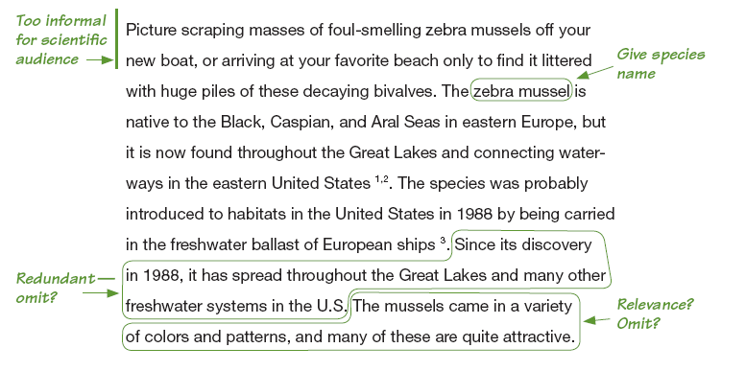
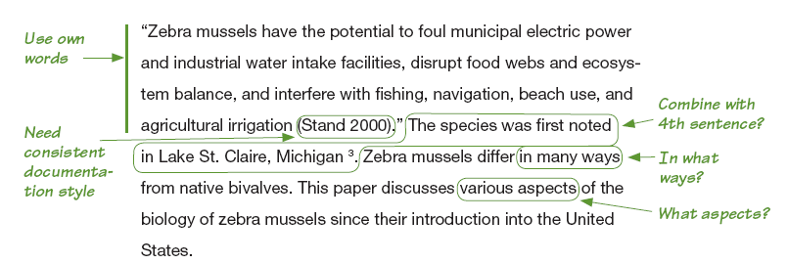

Slide 8
Checking Content and Structure:
Improve logic, continuity, and balance.
Omit unnecessary material.
Check for completeness and consistency.
Improving Paragraph:
Present coherent units of thought.
Make paragraphs work as integrated parts of the text.
Vary your sentences.
Pay attention to the structure, length, and rhythm of your sentences.

Slide 9

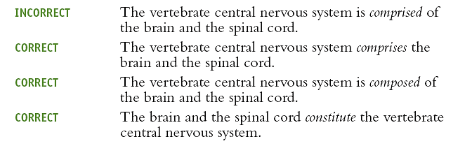
Writing Clear, Accurate Sentences:
Use words that say precisely what you mean.

Slide 10
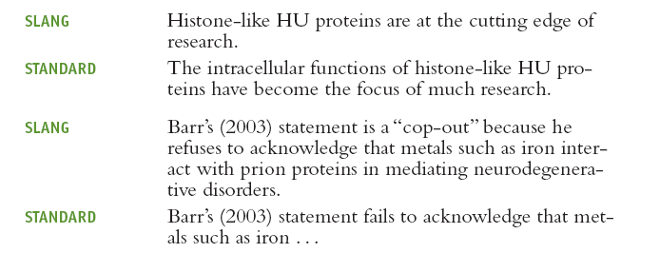
Avoid slang:
Slang is the informal vocabulary of a particular group of people.

Slide 11

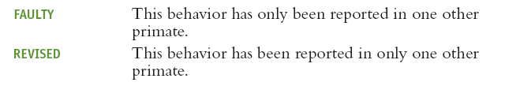
Revise misplaced modifiers.
Modifying words, phrases, or clauses should relate clearly to the words they are meant to describe. If they do not, the sentence may be confusing, even ludicrous.

Slide 12
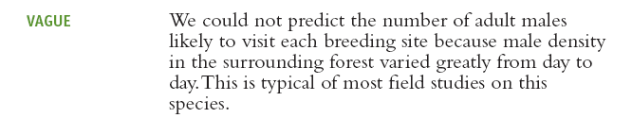

Avoid vague use of this, that, it, and which.
Do not use these pronouns on their own to refer to whole ideas; you may lose the reader. To avoid confusion, use clear, specific wording.

Slide 13

Make comparisons complete.
Add words if necessary to make comparisons or contrasts accurate and unambiguous.

Slide 14
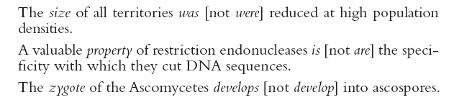
Make each verb agree with its subject.

Slide 15
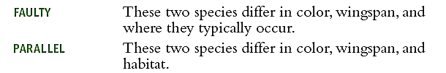
Put related elements in parallel form.
When you link two or more words, phrases, or clauses in a sentence, put them in the same grammatical form.
Such parallelism makes your writing easier to read and emphasizes the relationship between items or ideas.

Slide 16
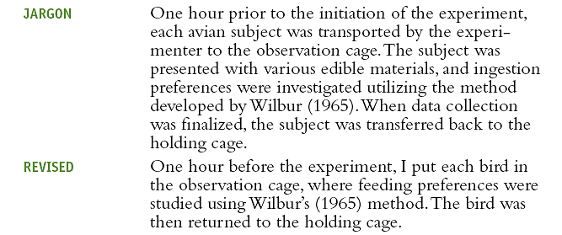
Write in a direct, straightforward manner; avoid jargon.
Do not assume that to sound like a biologist you must write dry, stilted, and boring prose or that complex ideas must be couched in equally complex, convoluted sentences.
Biology instructors, along with editors and readers of biological journals, prefer clear, straightforward writing simple but effective prose that quickly illuminates the author’s results and ideas.

Slide 17

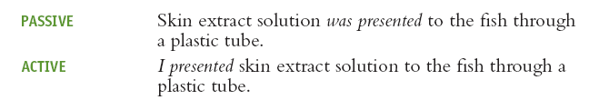
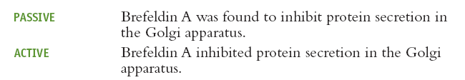
Avoiding wordiness:
Omit unneeded words; shorten wordy phrases.
Avoid repetition.
Use the passive voice sparingly.

Slide 18
Punctuation:
Comma (,)
1. Use a comma to separate introductory material from the rest of the sentence.
2. Use a pair of commas to set off insertions or elements that interrupt the flow of a sentence.
3. Use a comma to separate all items in a series, including the last two.
4. Use a comma to separate independent clauses linked by a coordinating conjunction (and, but, or, for, nor, so, yet).

Slide 19
Punctuation:
Semicolon (;)
1. Use a semicolon to join two independent clauses not linked by a coordinating conjunction (and, but, or, for, nor, so, yet).
2. Use a semicolon to connect two independent clauses joined by a conjunctive adverb (such as however, moreover, nevertheless, furthermore).
3. Use a semicolon to clarify the meaning of a series of items containing internal commas.

Slide 20
Punctuation:
Colon (:)
1. Use a colon to introduce items in a series.
2. Use a colon between two independent clauses when the second clause explains or clarifies the first one.
3. Use a colon to formally introduce a direct quotation.
Dash (-)
The dash is used to separate material abruptly from the rest of the sentence for clarity, emphasis, or explanation.

Slide 21

Punctuation:
Parentheses ()
1. Use parentheses to insert explanatory or supplemental information into a sentence.
2. Use parentheses with a series of items introduced by letters or numbers, especially when you are listing many items or several long items.

